Slide 1

Title: Vote-Xpress: An Interactive Online Voting System
Course: Advanced Data Structure (CSE343)
Submitted By: Aditya Raj (12305995)
Guided By: Dr. Sarneet Kaur
Term: June–July 2025
Description:
Vote-Xpress is a Python-based desktop application that enables secure, paper-free, and interactive digital voting with real-time results and built-in civic learning tools.

Slide 2
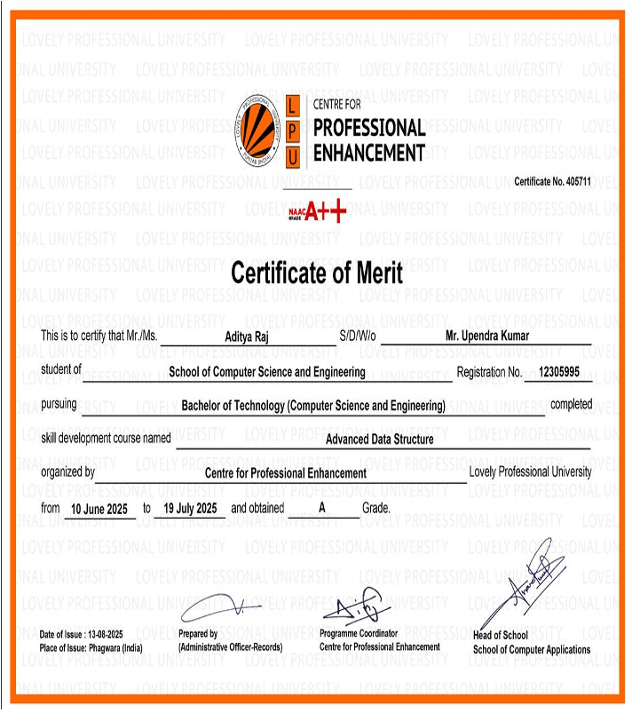

Slide 3
Project Introduction
Vote-Xpress is a small digital voting system that we developed during our summer training.
The main idea of this project is to replace paper-based voting with a smart, secure, and easy-to-use computer program.
It allows users to register, cast their votes, and instantly see the results without manual counting.
Our system also adds an AI chatbot, civic quiz, and motivational slogans to make the process more interactive and educational.
This project shows how technology can make elections faster, fairer, and more transparent.

Slide 4
Background and Motivation
In our daily life, we often see voting done on paper or by using EVM machines.
These methods take time, need more manpower, and may have counting mistakes.
Sometimes people also lose interest because the process looks boring and slow.
We wanted to design a system that can make voting quick, simple, and interesting.
That is why we created Vote-Xpress – a platform where voting happens through a few mouse clicks, results come live on screen, and users also learn civic facts during the process.

Slide 5
Objectives of the Project
The main objectives of Vote-Xpress are:
To create a secure electronic voting system that prevents duplicate votes.
To build a friendly interface that anyone can use easily.
To show live result graphs for quick and clear outcomes.
To add a chatbot for helping users and answering common questions.
To include a quiz and feedback form to make the app educational.
To provide a password-protected admin panel for result declaration.
These goals helped us stay focused on making the system both useful and interactive.

Slide 6
Tools and Technologies Used
We built our project completely using Python 3.12 because it is simple and powerful.
The Tkinter library was used for designing the graphical interface of windows, buttons, and forms.
We also used the following libraries:
threading – to handle tasks like chatbot responses without freezing the screen.
json – for temporary data storage.
datetime and math – for timers and calculations.
requests – to connect our app with the Google Gemini API chatbot.

Slide 7
Major Functional Modules
Splash Screen: Displays the Digital India logo and animated welcome message before launching the main app.
Registration Module: Allows new users to register with their name and voter ID; the system validates the entry.
Voting Module: Presents a list of candidates and lets each user vote only once. Duplicate attempts are automatically blocked.
Result Module: Continuously displays live results with graphical bars showing vote counts per candidate.
Admin Panel: Accessible only through a password; allows authorized users to declare official results.
Quiz Module: Contains multiple-choice civic questions that test users’ awareness of democracy and elections.
Chatbot Module: Integrated with Gemini API; provides instant answers and guidance in natural language.
Feedback Module: Collects ratings and comments from users to help improve future releases.
Together, these modules make the system complete and interactive, combining both functionality and learning.

Slide 8
User Interface and Experience
We kept the design simple and colorful so anyone can use it without confusion.
The main dashboard gives buttons for each feature such as registration, vote, quiz, chatbot, and feedback.
The color theme follows the Indian flag colors – saffron, white, green, and blue – to match the Digital India spirit.
Every screen has clear labels, confirmation messages, and friendly instructions.
Animations and timers make the app look lively and modern without being complicated.

Slide 9
Key Learnings
Through this training project we learned many practical skills beyond classroom theory.
We understood how to design a real Python application from start to finish.
We learned about GUI creation, API use, threading, and testing.
We experienced the importance of clean code and user-friendly design.
Teamwork taught us planning, communication, and sharing responsibility.
Finally, we gained confidence to present and demonstrate our own software.
This project was a complete learning experience in software development.

Slide 10
Conclusion and Acknowledgment
Conclusion:
Vote-Xpress fulfills its purpose as a safe, interactive, and educational voting platform.
It makes voting transparent, fast, and interesting and supports the goal of Digital India – Smart and Transparent Democracy.
Acknowledgment:
We thank Dr. Sarneet Kaur for her guidance and constant support.
We also thank our faculty, friends, and family for encouragement throughout the training.

Slide 11
References:
Python Documentation – https://docs.python.org/
TkDocs – https://tkdocs.com/
Google Gemini API – https://ai.google/
Election Commission of India – https://eci.gov.in/

Slide 12
THANK YOU

